Slide 1


New for 2019!

Slide 2


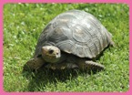
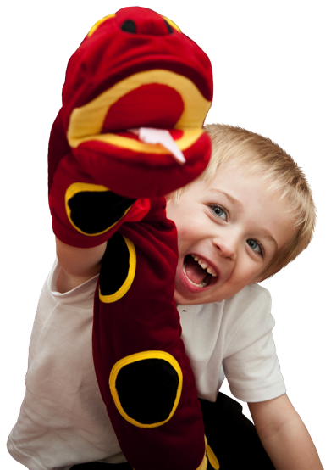
Who is Jolly English for?
Available now!
Jolly English is an English language course that has been carefully developed and sequenced for pre-school children who have little or no knowledge of English.
Join Inky Mouse and her friends, Snake and
Bee as they discover new words and phrases
using songs, games, chants and stories
that bring the course to life and develop
children’s English language.

Slide 3
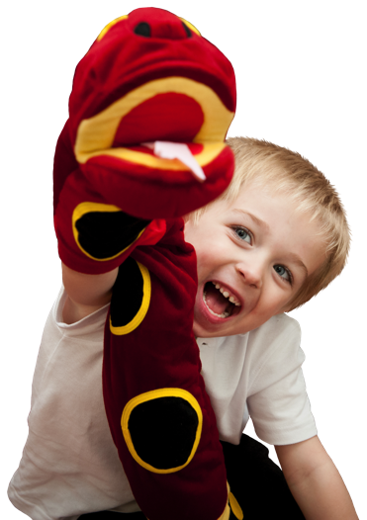
Why choose Jolly English?
Available now!
Using the tried and tested principle of Presentation and Practice, children are introduced to new words and phrases.
New language is introduced through a series of topic-based units.
Age-appropriate activities using songs, chants, games and role-play.
Multi-sensory activities hone children’s listening and
speaking skills.
All 42 sounds are introduced in the Jolly Phonics
sequence.
Flexible, fun and easy to implement in school.

Slide 4



Jolly English Programme
Available now!
Two levels of Jolly English are available.
Each level provides 44 lessons, which take approximately 45 minutes each.
Each level has 8 fun topic-based units
and a welcome unit.
Additional resources, including
flashcards and puppets
are provided to support the teaching.

Slide 5
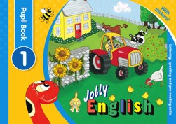
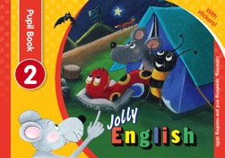
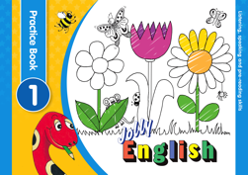
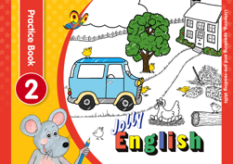
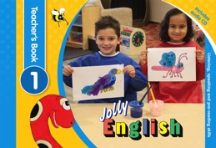

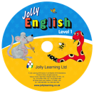
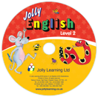
Jolly English Levels
Available now!
Level 1
Level 2
Each level of Jolly English comprises
A 48-page full-colour Pupil Book,
with stickers
A 48-page black-and-white
Practice Book
A 112-page full-colour
Teacher’s Book, with audio CD

Slide 6

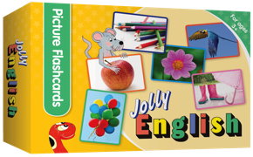


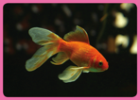
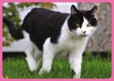

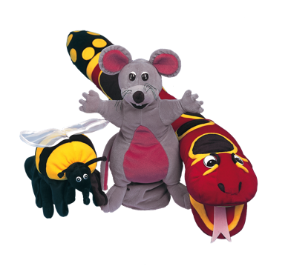


Jolly English Resources
Available now!
In addition, the following resources are used to support the teaching in both levels:
296 flashcards (colour-coded according to topic)
Snake, Inky and Bee puppets
A beanbag (for circle-time games)

Slide 7
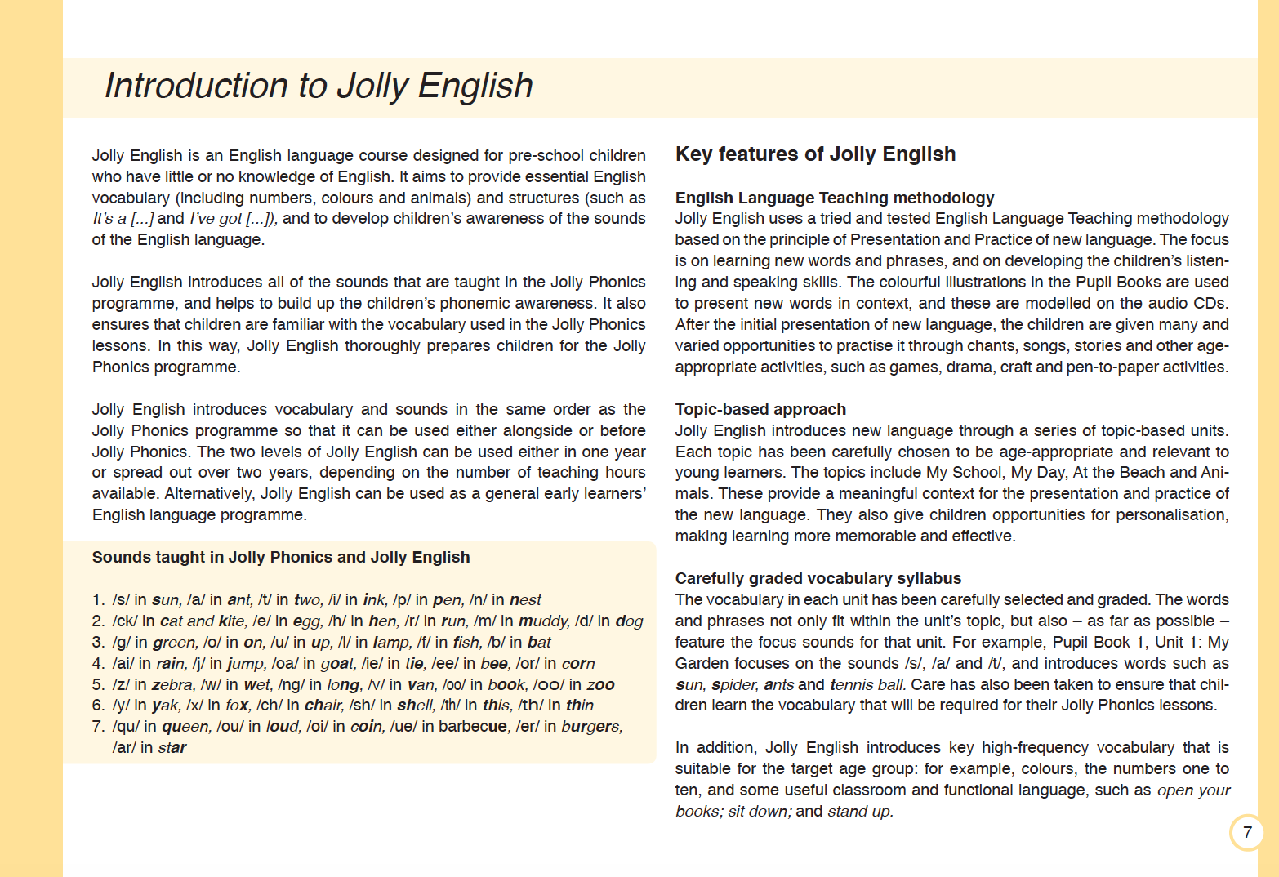
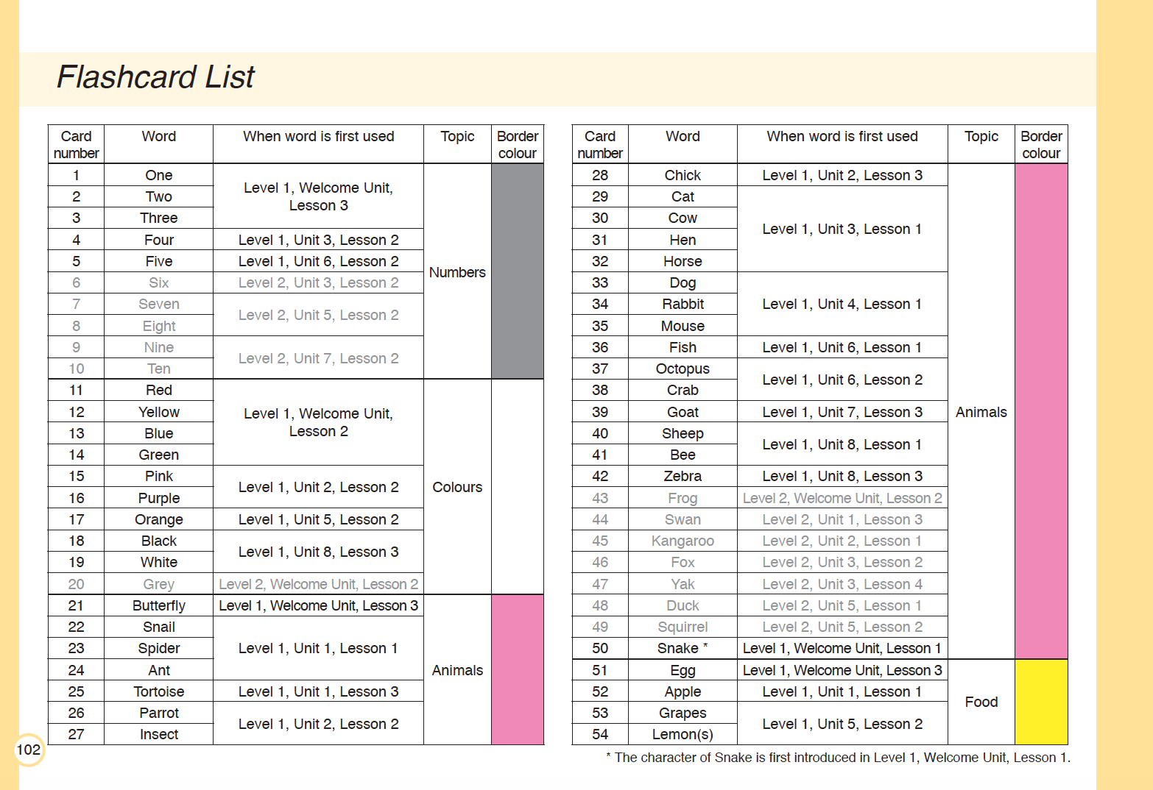
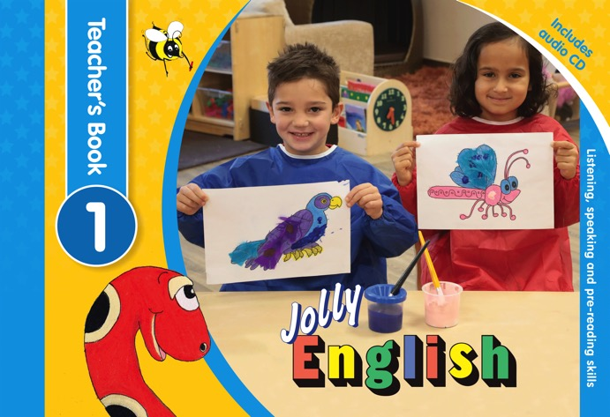
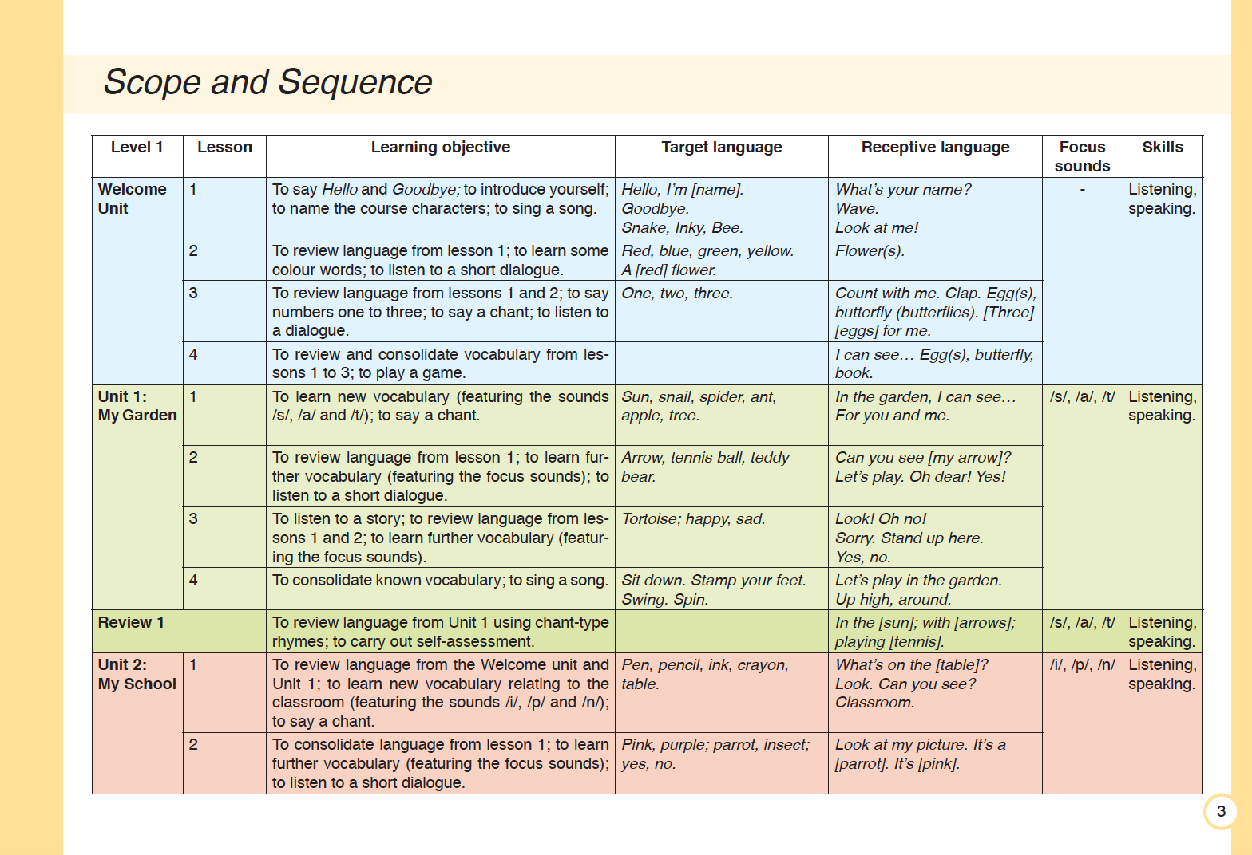
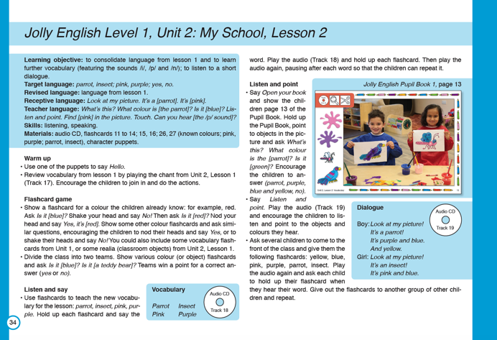
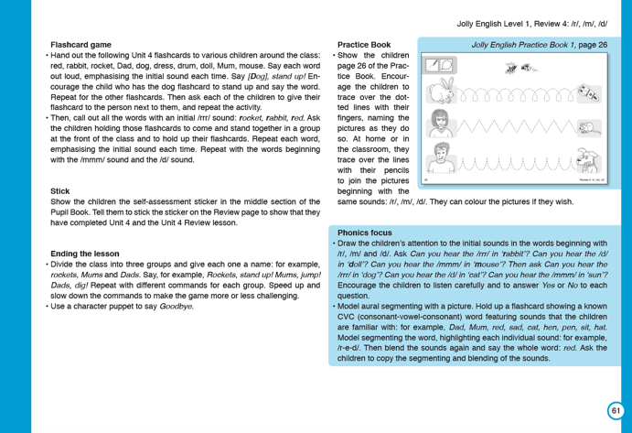
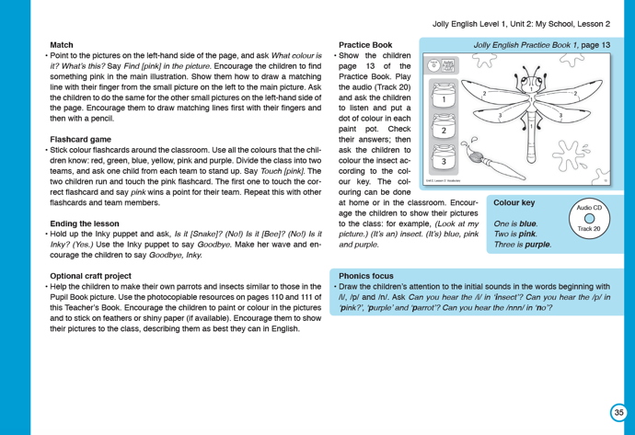
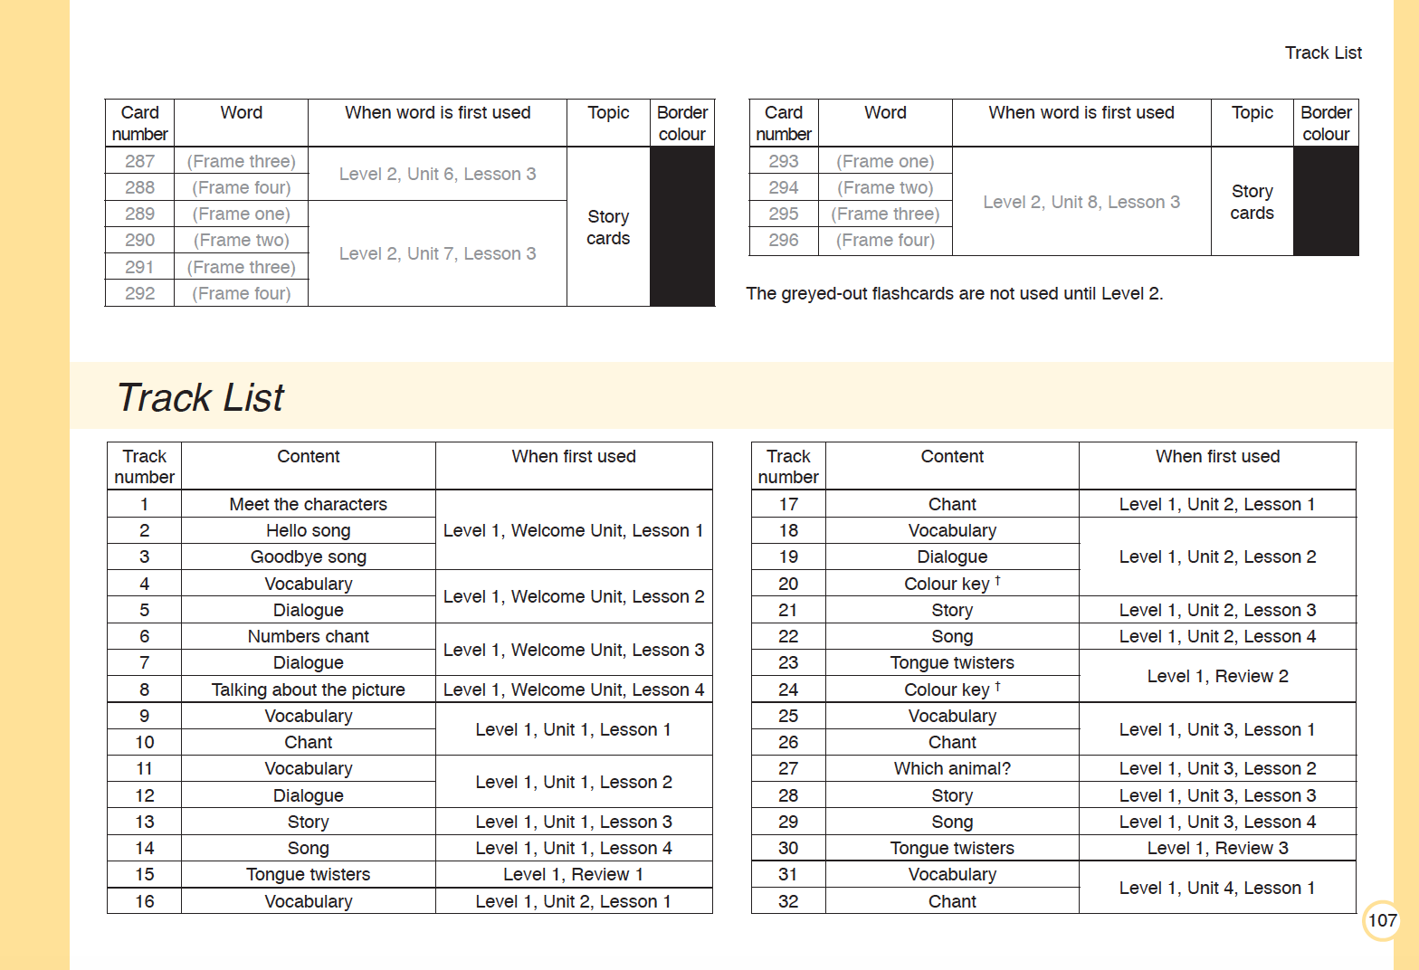
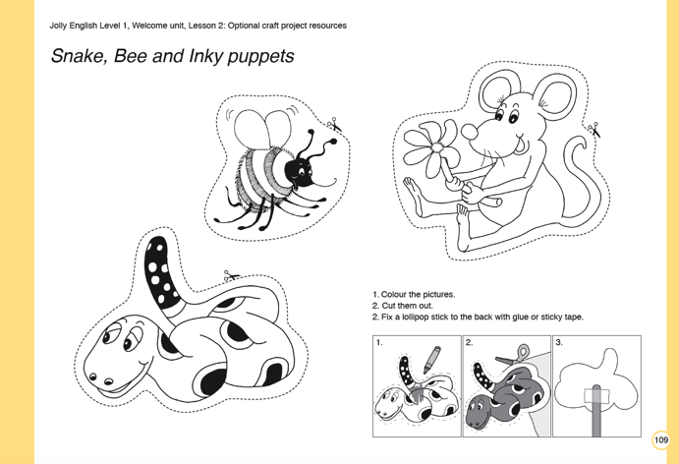
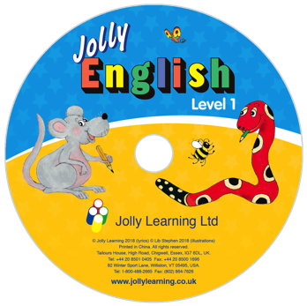
Jolly English Teacher’s Books
Available now!
112-page Teacher’s Books with...
Scope and sequence
Detailed introduction
Easy-to-follow lesson plans
Phonics focus
Flashcard and track lists
Photocopiable resources
Audio CD or download
Over 60 tracks!

Slide 8
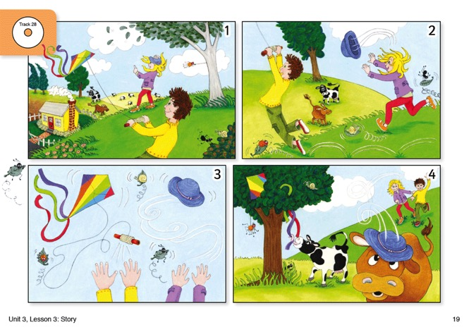
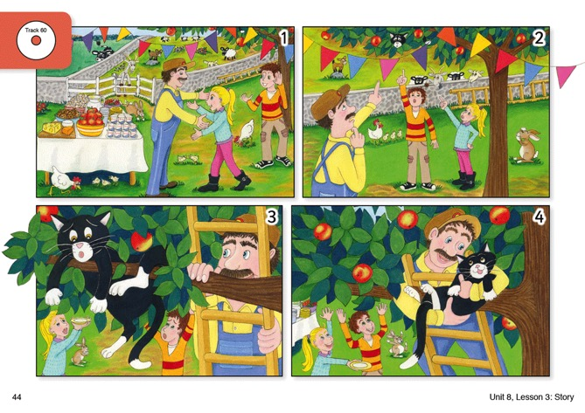
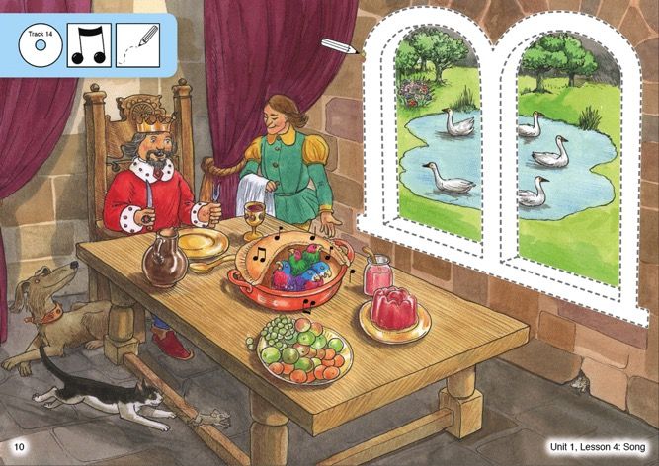
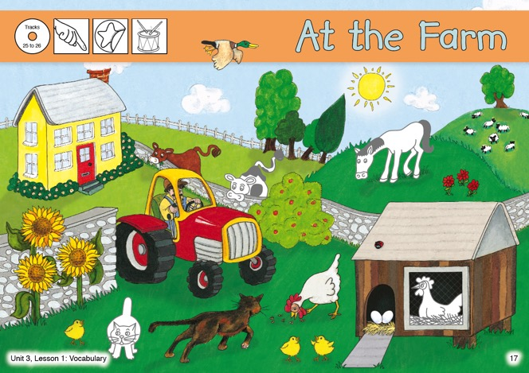
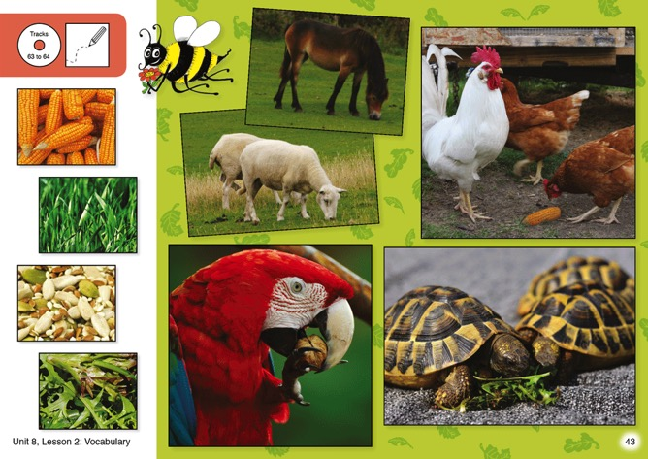
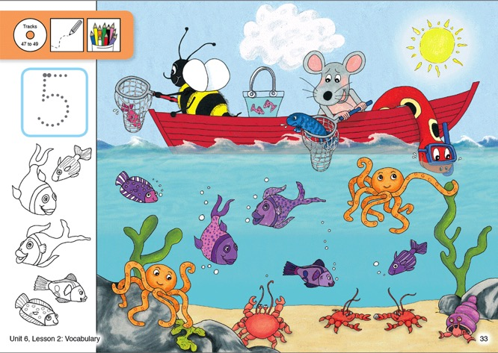
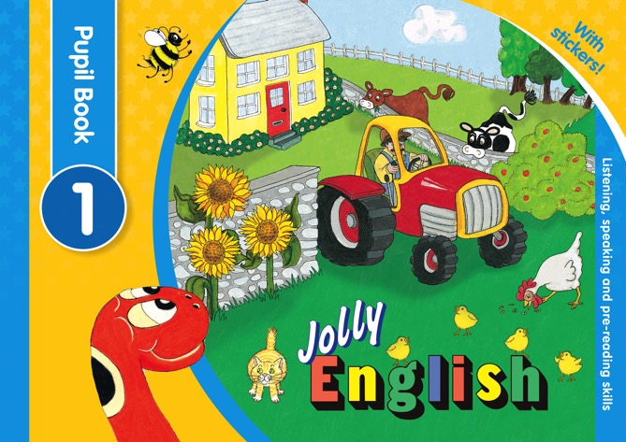
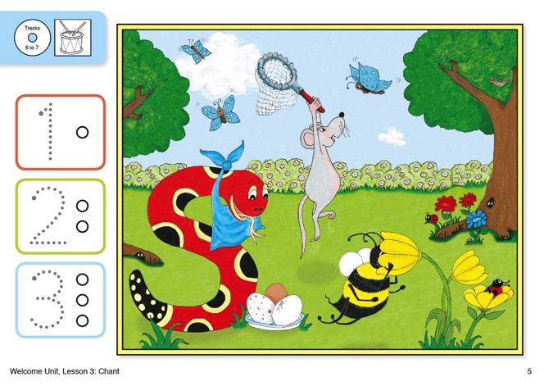
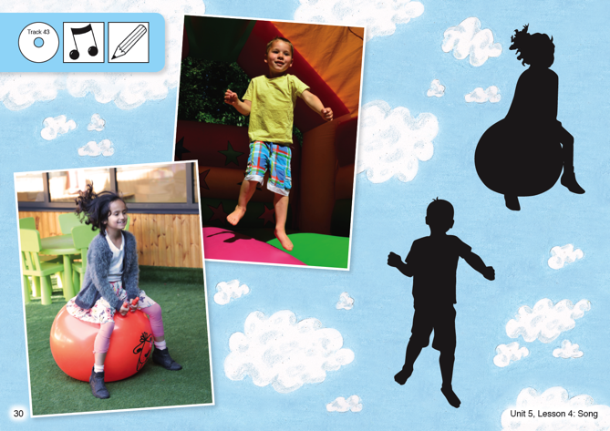
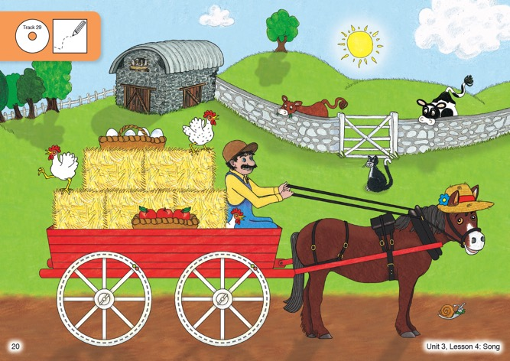
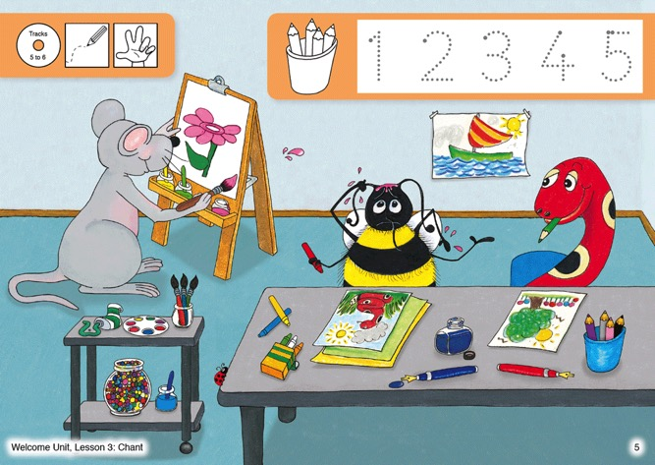
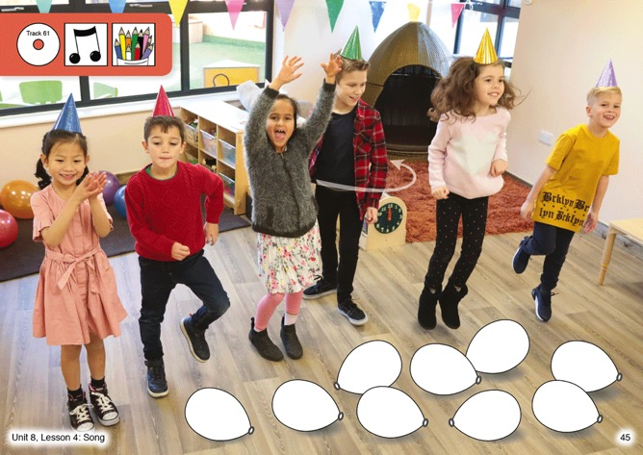

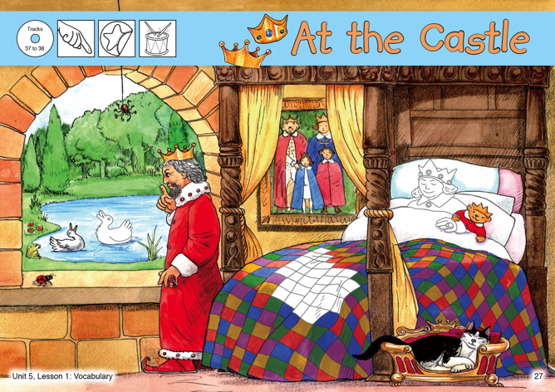

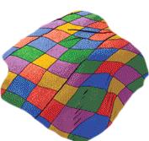
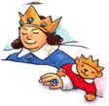

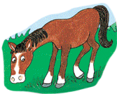

Jolly English Pupil Books
Available now!
48-page full-colour write-in Pupil Books with...
Stories
Colouring activities
Matching activities
Counting activities
Tracing activities
Sticker activities

Slide 9
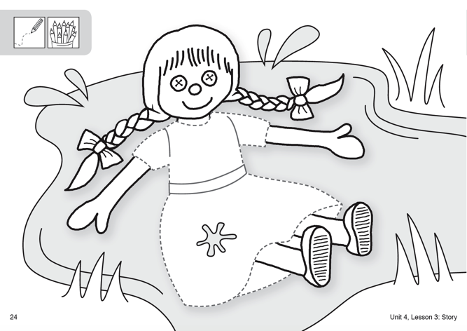

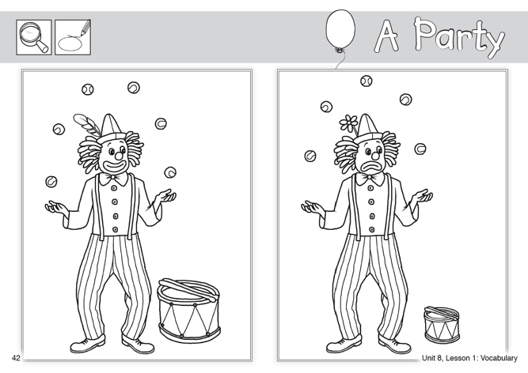
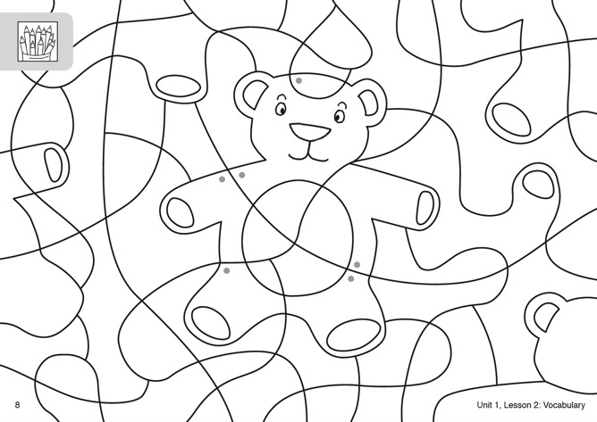
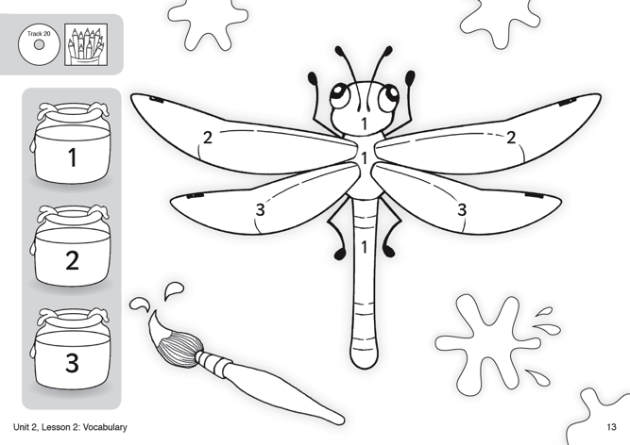
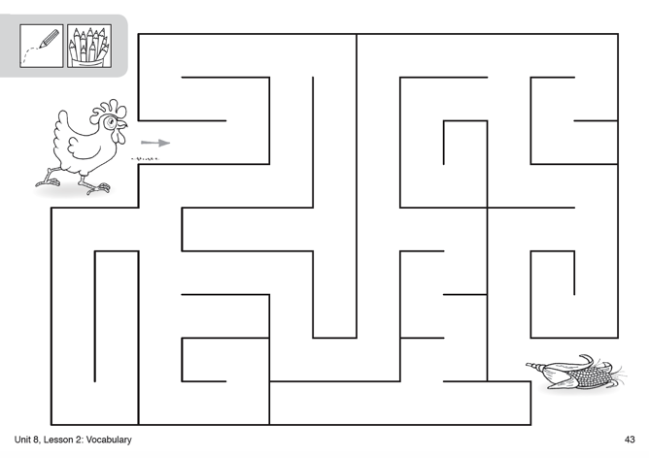
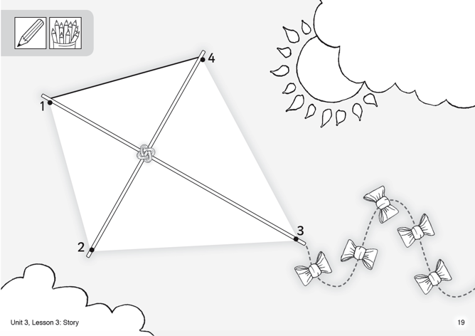
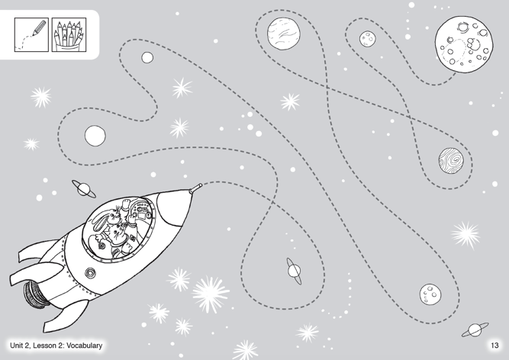
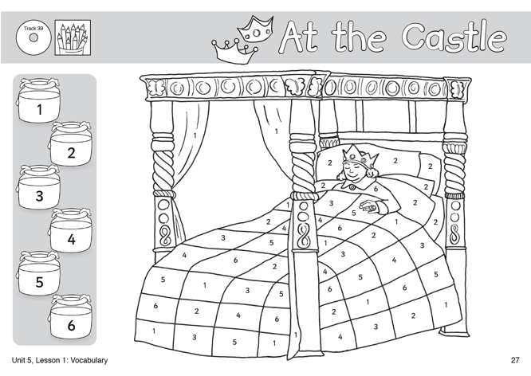
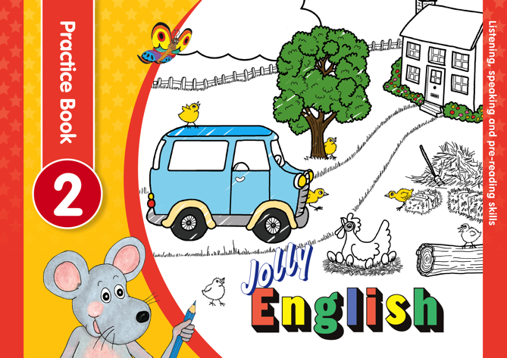
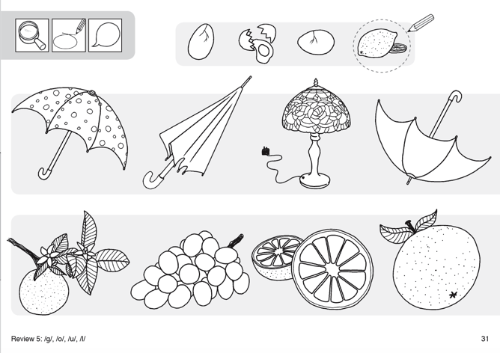



Jolly English Practice Books
Available now!
48-page black-and-white Practice Books with...
Tracing activities
Colour-by-numbers
Puzzles
Mazes
Dot-to-dot
Odd-one-out

Slide 10
















Jolly English Flashcards
Available soon!
296 flashcards
15 topics
Numbers
Colours
Animals
Food
Toys
At school
At home
Outside
Clothing
Parts of the body
Weather
Action verbs
Characters
Opposites and adjectives
Transport

Slide 11

Jolly English Teacher’s Kit
Available now!
The Jolly English Teacher’s Kit includes the following:
Jolly English Teacher’s Book 1
Jolly English Teacher’s Book 2
Jolly English Pupil Book 1
Jolly English Pupil Book 2
Jolly English Practice Book 1
Jolly English Practice Book 2
296 Picture Flashcards
Beanbag (used in games)
Snake, Inky and Bee Puppets

Slide 12




Jolly English Pupil Sets
Available now!
Pupil Set 1 contains...
Jolly English Pupil Book 1
Jolly English Practice Book 1
Pupil Set 2 contains...
Jolly English Pupil Book 2
Jolly English Practice Book 2

Slide 13











Jolly English
Available now!

