Slide 1
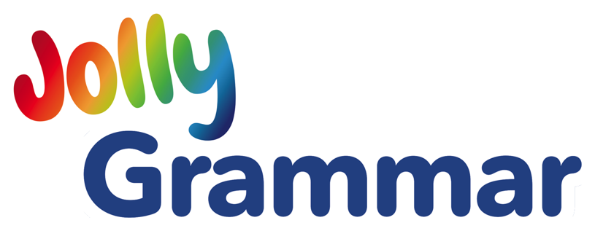
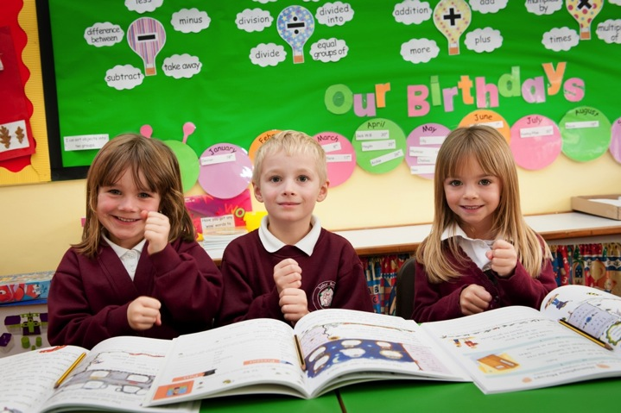
Leading the teaching of literacy
All About Jolly Grammar
Presentation for Teachers and Parents
Notes:
• Developed by practicing classroom teachers to:
• provide a systematic approach to teaching spelling, grammar and punctuation
• develop the children’s writing skills.
• Concentrates on the structural aspects of literacy teaching and is intended to be part of a broader literacy programme.
• Children should relate their grammar skills and understanding to other areas of literacy learning e.g. storybook reading and creative writing.
• This enriches their learning and promote stronger expression, both written and oral.

Slide 2
An integrated programme that grows with the children
ages
4-5
ages
5-6
ages
6-7
ages
7-8
ages
8-9
ages
9-10
ages
10-11
Phonics
Grammar 1
Grammar 2
Grammar 3
Grammar 4
Grammar 5
Grammar 6
Phonics
Grammar, Spelling and Punctuation
Jolly Phonics Readers
Raising Standards for All
Jolly Grammar Presentation
Notes:
• The Grammar programme develops and expands the teaching of Jolly Phonics, which starts in the first year of school, and is based on the five key skills that help children understand the code of English.
• Together with the Jolly Phonics Readers, it delivers an integrated literacy programme, enabling children to:
• spell and punctuate more accurately
• use a wider vocabulary
• have a clearer understanding of how language works
• and become independent readers of storybooks, who are ready for other, more challenging text.
• Currently, Jolly Phonics provides six years of literacy teaching, soon to be extended to seven.

Slide 3
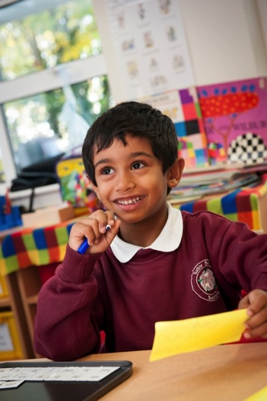
The 5 Basic Skills
Jolly Phonics continues with Jolly Grammar and builds on the foundation and its 5 key skills:
1. Learning the letter sounds
2. Learning letter formation
3. Blending
4. Identifying sounds in words (segmenting)
5. Tricky words
Raising Standards for All
Jolly Grammar Presentation
Notes:
• Jolly Grammar continues with grammar, spelling and punctuation building upon early skills taught in the first year of school, and is based on these five key skills.
• The aim of Jolly Phonics is to teach the children to write independently, listening for the sounds in words and choosing letters to represent them.
• At this stage, the letters chosen may not, in fact, be the correct spelling (as there are often different ways to write the same sound) but the writing will be phonetically understood.

Slide 4
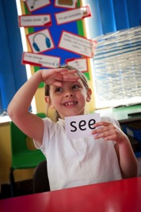
Spelling, Grammar and Punctuation
Extends Jolly Phonics to a 7-year literacy programme
Revises and extends phonics knowledge
Systematic teaching of spelling, grammar and punctuation
2 lessons per week – 1 spelling, and 1 grammar or punctuation
Multi-sensory teaching that lifts teaching off the pages
Improves children’s written and oral expression
Raising Standards for All
Jolly Grammar Presentation
Notes:
• Our Grammar materials offer a systematic approach to teaching the structural aspects of language in a fun, multisensory way.
• A pattern of ‘teach, reinforce, consolidate and extend’ is followed through the levels and systematic revision is built into all the lesson plans.
• There are a range of different books available, all focused on developing the children’s reading and writing skills.
• The Grammar range is part of the Jolly Phonics literacy programme, providing 7 years of literacy teaching to help children become confident, independent readers, with excellent written and oral expression.

Slide 5
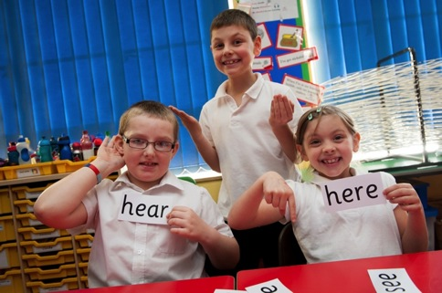
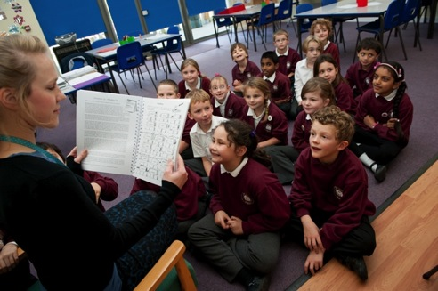
Jolly Grammar 1-6
Jolly Grammars 1-6 each contain one year of spelling, with two lessons per week:
1 x Spelling lesson
1 x Grammar OR Punctuation lesson
Raising Standards for All
Jolly Grammar Presentation
Notes:
The Grammar programme provides two lessons a week: one on spelling and one on grammar or punctuation. In this way, it continues to reinforce and extend the phonic knowledge learnt in Jolly Phonics. It additionally allows the teacher flexibility to cover other literacy content or projects throughout the week whilst ensuring key grammatical concepts are covered.

Slide 6
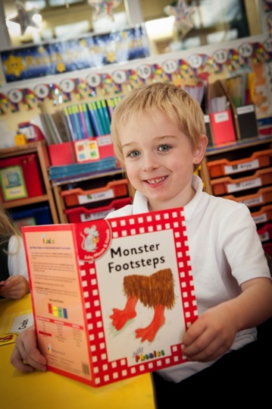
Jolly Grammar - Spelling
Spelling lessons provide:
Reinforcement of phonic knowledge (digraphs, alternatives, tricky words)
Extension of phonic knowledge
New spelling patterns
Consonant blends
Short vowels
Syllables
Raising Standards for All
Jolly Grammar Presentation
Notes:
Spelling becomes more accurate with practice as phonics knowledge is reinforced and extended with new spelling patterns and rules.

Slide 7
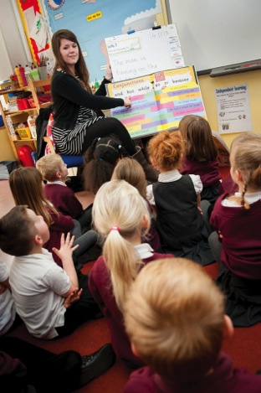
Jolly Grammar – Grammar and Punctuation
Grammar and punctuation lessons provide:
Sentence writing
Parts of speech / parsing
Verb tenses
Punctuation
Dictionary work
Vocabulary work
Proofreading
Raising Standards for All
Jolly Grammar Presentation
Notes:
The grammar and punctuation lessons aim to build on this foundation and give the children the skills they need to improve the clarity and quality of their writing.

Slide 8
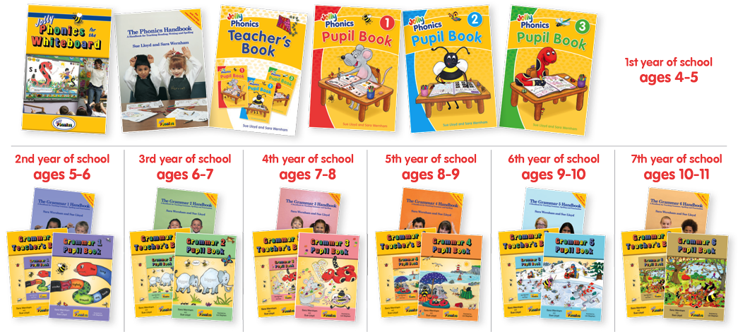
Core materials: Write-in Pupil Books or Worksheets
Raising Standards for All
Jolly Grammar Presentation
Notes:
• The Grammar programme can currently be taught in two ways:
1. Handbook: a teacher’s resource with lesson plans and photocopiable worksheets.
2. Teacher’s Book and Pupil Books:
• A teacher’s manual with lesson plans next to reduced Pupil Book pages,
• A write-in colour Pupil Book for each child.
These can be purchased separately or as class sets.

Slide 9
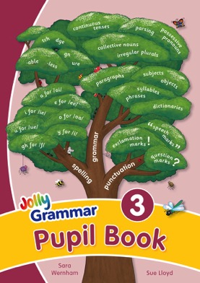
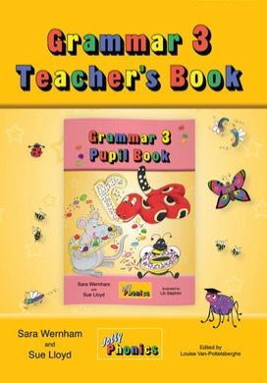
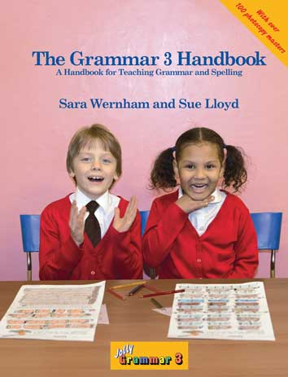
Handbooks and Pupil Books
Similar format to The Phonics Handbook and Phonics Pupil Books
Detailed introduction
Teacher’s notes for every lesson
Photocopiable worksheets in the Handbooks
Colour lesson pages in the Pupil Books
Extension activities
Raising Standards for All
Jolly Grammar Presentation
Notes:
• All Handbooks and Pupil Books follow a similar format.
• Both provide teaching material for 36 weeks. There are 2 lessons per week: one on spelling, one on grammar/punctuation.
• In this way, Grammar continues to consolidate and extend the phonic knowledge learnt in the first year of Jolly Phonics, so that spelling can become more accurate with practice.

Slide 10
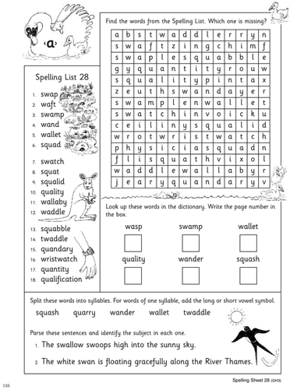
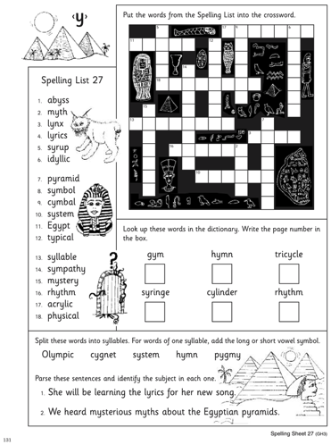
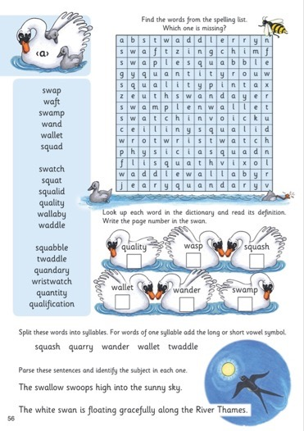
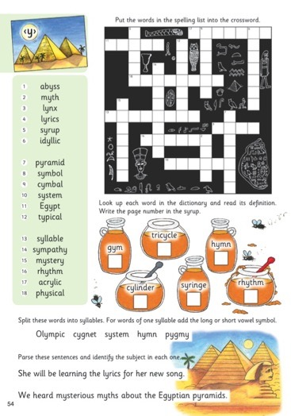
Handbooks and Pupil Books
Same content, different delivery
Handbooks
Pupil
Books
Raising Standards for All
Jolly Grammar Presentation
Notes:
• As you can see from these sample spelling lessons from the Handbooks and Pupil Books, the content covered and the lesson pages/sheets are almost identical – same content, different delivery.
• Each spelling lesson follows a similar format:
• After a short burst of revision, the main teaching point - typically a new spelling pattern - is introduced to the class.
• After some practice, the children do the activities on their spelling sheets.
• Then they are given some word and sentence dictation, which (in the early levels) is mostly decodable or uses tricky words already taught.
• Finally, the class go over the spelling words in their spelling homework book, or Pupil Book, in preparation for their spelling test later in the week.

Slide 11
Spelling and Grammar
Consolidates and extends phonic knowledge, and introduces and develops key grammar, punctuation and writing skills
, !
L’s
“
spelling
homophones
parts of speech
object
suffixes
dictionaries
word
webs
prefixes
subject
opposites
vocabulary skills
”
contractions
syllables?
paragraphs
Raising Standards for All
Jolly Grammar Presentation
Notes:
• By the end of the first year of Jolly Phonics, the aim is for children to be on their way to becoming independent readers and to be able to write news freely. The spelling will not always be accurate as there are often different ways of spelling the sounds, but it can be read, and it provides a great sense of achievement.
• However, while correct spelling is not the focus of teaching in the first year, it becomes increasingly important from now on. Moreover, the children need to develop their writing skills, and become aware that they are writing for a purpose. This means making sure that what they write can be understood and for this they need to work on other skills.
• So what do children need next…?
• Spelling: They need to consolidate and extend their phonic knowledge, revising the tricky words and alternative vowel spellings, and learning new ones, along with other common spelling patterns, in order to improve their reading and spelling.
• Grammar: They need to learn and develop essential grammar, punctuation and writing skills to improve the clarity and quality of their writing. This includes:
Parts of speech, verb tenses & parsing
Sentence writing, vocabulary work & punctuation
Alphabet, Dictionary & Thesaurus work
Proofreading

Slide 12
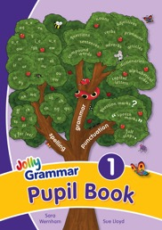
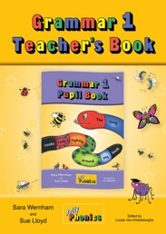
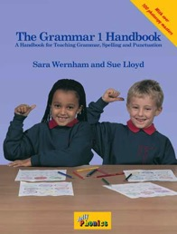
Jolly Grammar 1 Topics
Revision and extension of earlier phonics teaching
Vowel digraphs
Alternative spellings of vowel sounds
Plural endings
Short vowels and consonant doubling
Tricky words
Consonant blends
Nouns – proper/common/plurals
Personal pronouns
Verbs
Conjugating verbs – past/present/future
Adjectives and adverbs
When to use a/an/the
Sentences – capital letters, full stops and speech marks
Parsing – identifying the parts of speech in sentences
Alphabetical order
Raising Standards for All
Jolly Grammar Presentation
Notes:
The Jolly Grammar programme provides two lessons a week: one on spelling and one on grammar. In this way, it continues to reinforce and extend the phonic knowledge learnt in Jolly Phonics, so that spelling becomes more accurate with practice. These are the topics covered in Jolly Grammar 1.

Slide 13
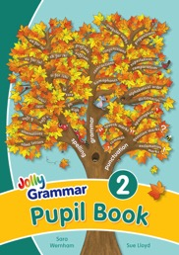
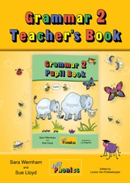
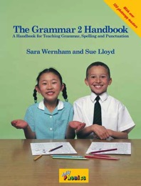
Jolly Grammar 2 Topics
Revision of elements covered in Grammar 1
New spelling patterns – ei, eigh, ture
Silent letters – b, c, h, k, w
Syllables
Identifying the short vowels
Spelling rules – consonant doubling and adding suffixes
Tricky word families
Further adjectives - possessive
Comparatives and superlatives
Prepositions
Conjunctions
Dictionary/thesaurus skills work
Punctuation
Exclamation marks
Apostrophes
Further sentence development
Raising Standards for All
Jolly Grammar Presentation
Notes:
The Jolly Grammar programme provides two lessons a week: one on spelling and one on grammar. In this way, it continues to reinforce and extend the phonic knowledge learnt in Jolly Phonics, so that spelling becomes more accurate with practice. These are the topics covered in Jolly Grammar 2.

Slide 14
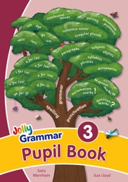
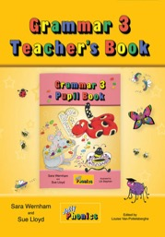
Jolly Grammar 3 Topics
Revision of elements covered in Grammar 1 & 2
New spelling patterns – tch; dge; ure; gn; gh; ex; n for /ng/; s, se and ze for /z/; a for /ar/; y for /i/; a for /o/; ere for /air; and eer and ere for /ear/
Suffixes – ‘less’, ‘able’ and ‘ful’
Proper adjectives
Nouns acting as adjectices
Collective nouns
Pronouns – possessive / subject and object
The present participle and the continuous tenses
Paragraphs
Subject and object in a sentence
Conjuctions
Questions and exclamations in speech
Raising Standards for All
Jolly Grammar Presentation
Notes:
The Jolly Grammar programme provides two lessons a week: one on spelling and one on grammar. In this way, it continues to reinforce and extend the phonic knowledge learnt in Jolly Phonics, so that spelling becomes more accurate with practice. These are the topics covered in Jolly Grammar 3.

Slide 15
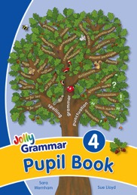
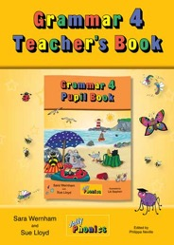
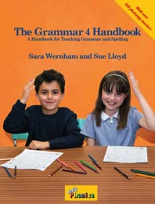
Jolly Grammar 4 Topics
Revision of elements covered in Grammar 1, 2 & 3
Nouns acting as concrete/abstract/possessives
The present participle as an adjective
Onomatopoeia
Clauses / independent clauses
Agreements
Hyphens
Sentence writing – statements and questions, compound sentences
Parsing verbs
Infinitives
Antonyms and synonyms
Homophones
Raising Standards for All
Jolly Grammar Presentation
Notes:
The Jolly Grammar programme provides two lessons a week: one on spelling and one on grammar. In this way, it continues to reinforce and extend the phonic knowledge learnt in Jolly Phonics, so that spelling becomes more accurate with practice. These are the topics covered in Jolly Grammar 4.

Slide 16
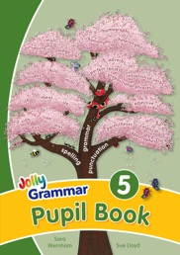
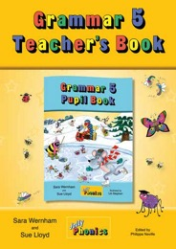
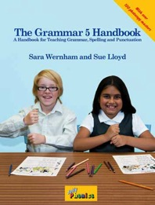
Jolly Grammar 5 Topics
Revision of elements covered in Grammar 1, 2, 3 & 4
Sentence walls
Simple and continuous tenses
Contractions and the verb ‘to have’
Adverb placement in sentences
Proofreading
Prepositional phrases
Compound subjects and objects
Transitive and intransitive verbs
The order of adjectives
Adverbs of manner, degree & place, time & frequency
Irregular plurals
Parenthesis
Homophones
Antonyms and synonyms
Raising Standards for All
Jolly Grammar Presentation
Notes:
The Jolly Grammar programme provides two lessons a week: one on spelling and one on grammar. In this way, it continues to reinforce and extend the phonic knowledge learnt in Jolly Phonics, so that spelling becomes more accurate with practice. These are the topics covered in Jolly Grammar 5.

Slide 17
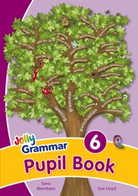
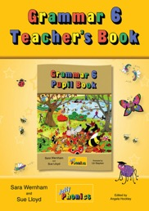
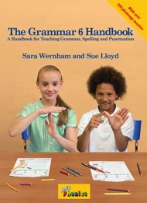
Jolly Grammar 6 Topics
Revision of elements covered in Grammar 1, 2, 3, 4 & 5
Prefixes and suffixes, and in particular numerical
More alternatives, they, great, ballet, fete, straight for /ai/
New spelling patterns/rules: ough
Silent letters: bt, te, th
Schwas –ity & -ety
Definite and indefinite articles
New parts of speech: countable and uncountable nouns, gerunds and modal verbals, and imperatives
Using semi colons and colons, using a comma after a fronted adverbial
Sentence structure, indirect objects, subject complements and passive agents
Alliteration, idioms, formal/informal writing
Raising Standards for All
Jolly Grammar Presentation
Notes:
The Jolly Grammar programme provides two lessons a week: one on spelling and one on grammar. In this way, it continues to reinforce and extend the phonic knowledge learnt in Jolly Phonics, so that spelling becomes more accurate with practice. These are the topics covered in Jolly Grammar 6.

Slide 18
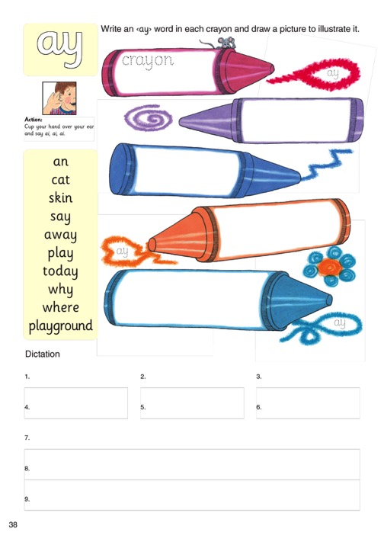
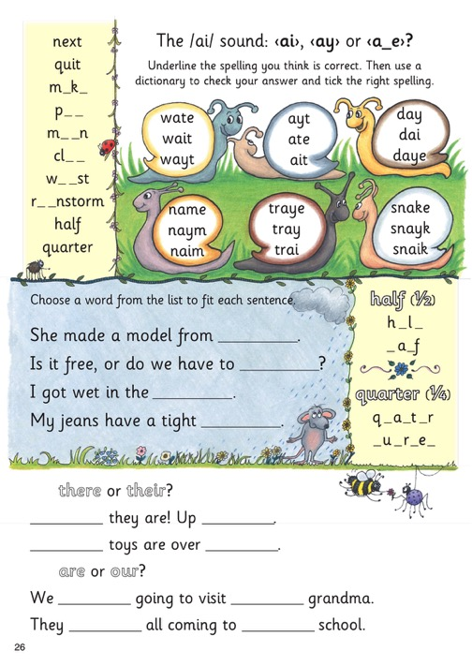
Spelling Progression
Grammar 1
Grammar 2
Raising Standards for All
Jolly Grammar Presentation
Notes:
• The alternative spellings of the vowel sounds is what makes learning English so tricky. The following pages show some examples of how the different spellings of vowel sounds are taught over the 5 levels.
• In the first year of grammar, the focus is on learning/consolidating the alternative spellings one at a time and using words that have that spelling.
• In the second year, the emphasis is on learning which of the main alternative spellings is the right one to use in a word.
• It is important that children understand what the spelling words mean, as well as knowing how to spell them correctly. In Grammar 1, they have to draw a picture of each word they write. In Grammar 2, they have to complete sentences using the correct word in context.
• There are more activities on the page, more reading and writing to be done and there is also some cross-over revision of the grammar learnt in the previous lesson.

Slide 19
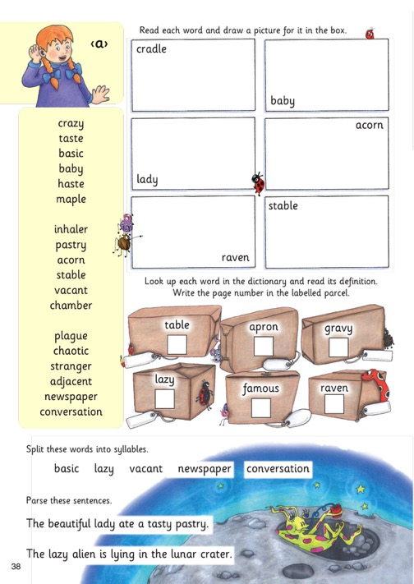
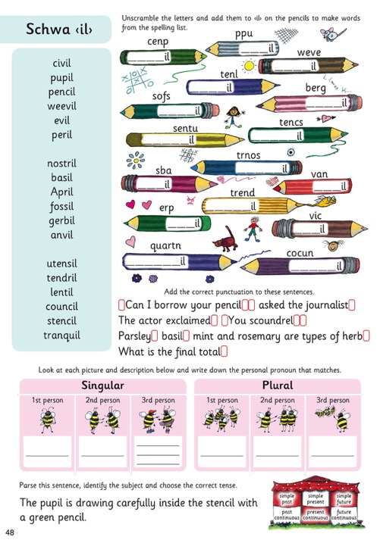
Spelling Progression
Grammar 3
Grammar 4
Raising Standards for All
Jolly Grammar Presentation
Notes:
• Grammar 3 continues to revise alternative spellings and introduce new ones. For example, they learn that a single vowel letter can sometimes make the long vowel sound without any influence from a ‘magic’ e (or other vowel): pastry, secret, child, only, menu.
• In Grammar 4, the alternative vowel spellings are no longer the main focus. There is still plenty of revision and consolidation, but the focus now is on words with schwas (neutral, unstressed vowel sounds), which make it difficult to spell a word correctly by listening for the sounds.
• The spelling lists in Grammar 3 & 4 are longer and contain more sophisticated vocabulary.
• As always, meaning and spelling are equally important. Grammar 3 has a regular dictionary activity to improve the children’s ability to look words up for spellings and meanings; in both levels, syllable work, parsing and identifying the subject of the sentence are also regular activities.
• A crossover between spelling and grammar continues, with regular activities on vocabulary skills (synonyms, antonyms, homophones, plurals, comparatives and superlatives, suffixes and prefixes) and punctuation.
• In Grammar 4,the parsing activity is extended to include identifying the tense and, later on, to identifying the grammatical person (first, second and third; singular or plural).

Slide 20
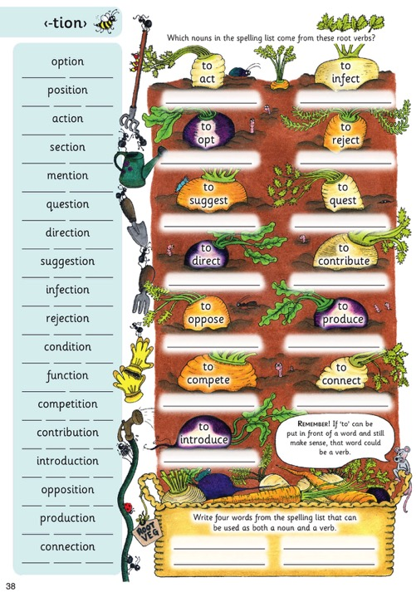
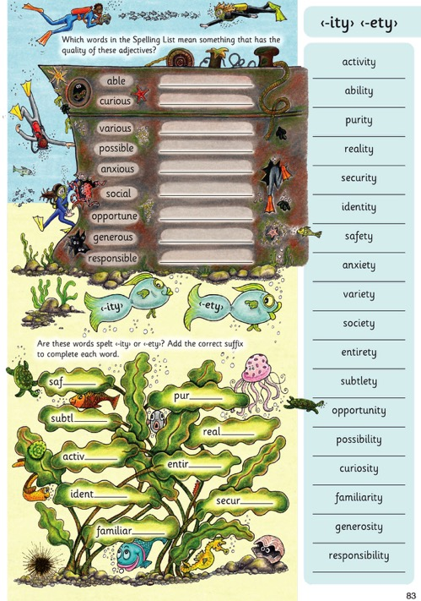
Spelling Progression
Grammar 5
Grammar 6
Raising Standards for All
Jolly Grammar Presentation
Notes:
• In Grammar 5, the emphasis is on root words and word families, prefixes and suffixes.
• This shows three of the four lessons which focus on different ways to spell /shun/ - which has a schwa or neutral vowel): -sion, -ssion, -cian and –tion.
• Notice the change in format: this is one of two spelling sheets per lesson. The dictation, parsing and cross-over activities are on a separate sheet.
• The aim in Grammar 6 is to consolidate the children’s knowledge and introduce new spelling patterns: its main focus is on the more unusual spellings for the vowel sounds, less common ‘silent letter’ digraphs, number prefixes, and closely related suffixes like <ity> and <ety>, <ious> and <eous>, and <ure> and <our>.

Slide 21
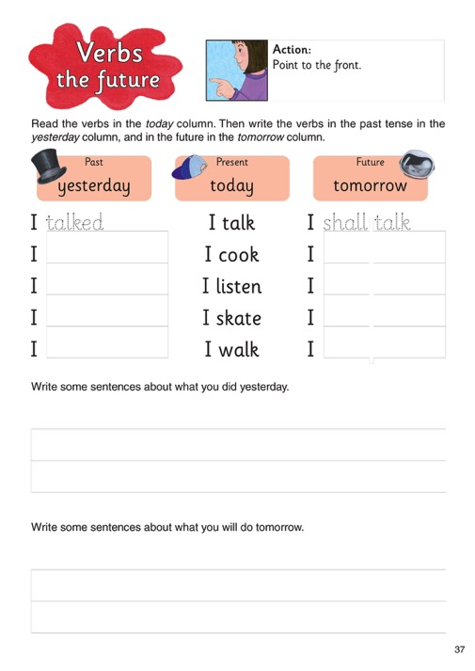
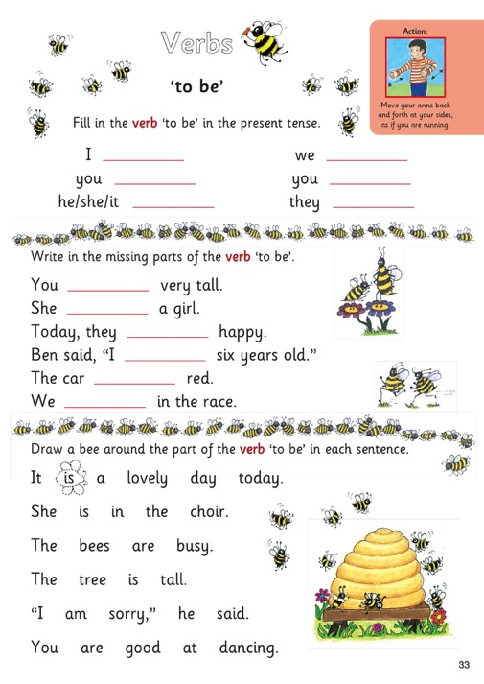
Grammar Progression
Grammar 1
Grammar 2
Raising Standards for All
Jolly Grammar Presentation
Notes:
• Unlike spelling, the grammar lessons cover many different topics so its format is less easily defined.
• However, the teacher’s notes have a clear structure: aim (teaching target), introduction (revision/preparation), main teaching point (lesson focus), grammar sheet (instructions and answers), extension activity, rounding off (going over worksheet as a class).
• In Grammar 1, the children learn that a sentence must have a verb and are shown how to form the three simple tenses: past, present, future. Each one has its own action: pointing backwards (past), pointing towards floor with palm of hand (present), pointing forward (future). They regularly conjugate verbs, using the actions for the personal pronouns (I, you, he, etc).
• In Grammar 2, the children learn that not all verbs are regular in the past and present tense. They are introduced to the irregular verb ‘to be’, which children find difficult to identify because of its irregular form and because it is not an obvious ‘doing’ word; however, it is used to form the continuous tenses, which are introduced in Grammar 3, so it is important for the children to recognise it.

Slide 22
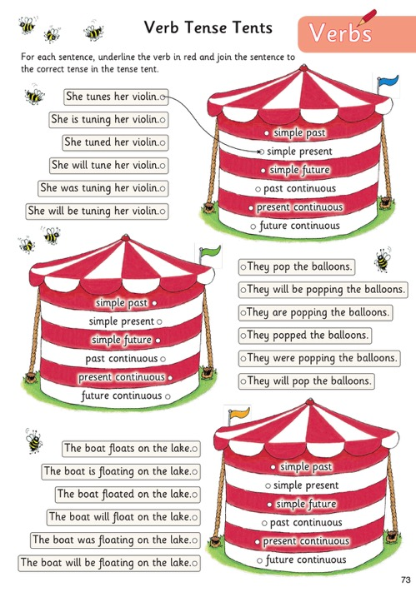
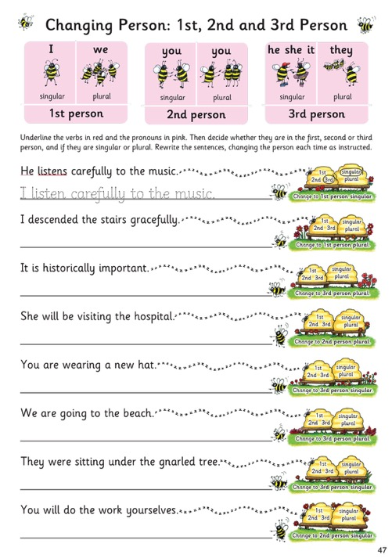
Grammar Progression
Grammar 3
Grammar 4
Raising Standards for All
Jolly Grammar Presentation
Notes:
• Grammar 3: Introduces the continuous tenses so the children need to be able to identify which of the six tenses is being used with confidence. The tense tents can be used in this way, either for children to copy or paste sentences into the correct tense tents, or for them to re-write the same sentence in each tense.
• Grammar 4: continues to revise the six verb tenses, using the tense tents. Plus:
• learn how to identify the grammatical person, working out whether the sentence is written in the first, second or third person, singular or plural. Identifying the tense and grammatical person is called ‘parsing the verb’.
• The children are also expected to be able to rewrite a sentence, changing the tense and grammatical person.

Slide 23
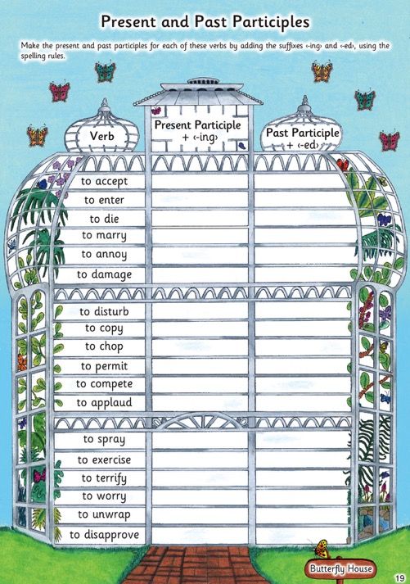
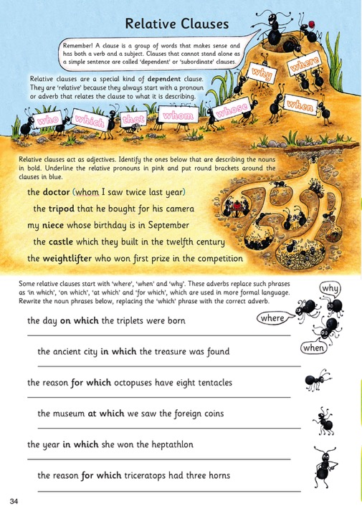
Grammar Progression
Grammar 5
Grammar 6
Raising Standards for All
Jolly Grammar Presentation
Notes:
• Grammar 5:
• Continues to revise the six verb tenses, using the tense tents
• Introducing the perfect tenses
• Looks at the irregular verb ‘to have’ in the past, present and future (used to form perfect tenses)
• Introduces the past participle (also used for form perfect tenses)
• Introduces the terms ‘transitive’ and ‘intransitive’ for verbs which have or don’t have a direct object.
• Grammar 6 introduces new elements of grammar, such as gerunds, countable and uncountable nouns, relative pronouns, linking verbs, modal verbs, relative verbs, adverbials, coordinating and subordinating conjunctions, and prepositional phrases acting as adjectives.
• Grammar 6 also helps children to develop a greater understanding of sentence structure, introducing indirect objects, relative clauses, complex sentences, imperatives, ‘to do’ as an auxiliary verb, colons and semicolons, and the passive voice.

Slide 24
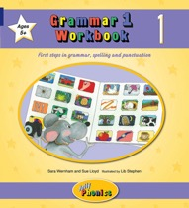
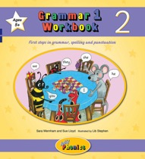
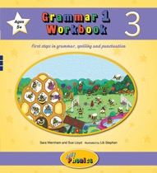
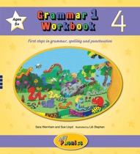
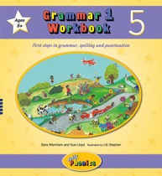
Supplementary material for Grammar 1 and 2
Grammar Workbooks – practice early grammar, spelling and punctuation concepts
Jolly Dictionary – for looking up and understanding new words
Grammar Songs – fun songs for grammar, spelling and punctuation concepts
Grammar Glossary – for a detailed explanation of grammar, spelling and punctuation terms
Blends Wheels – develop awareness of initial and final blends
Grammar Big Books – for introducing grammar elements to your class
Raising Standards for All
Jolly Grammar Presentation
Notes:
Grammar Big Books:
• Grammar Big Books are available for Grammar 1 & 2.
• They can be used alongside the core products to supports the teaching of grammar, spelling and punctuation
• The 12 large illustrations allow the topics to be explored with the whole class in a fun and engaging way, and the wipe- clean plastic sheet can be clipped to the page for extension activities.
Jolly Dictionary:
• This colour coding is used throughout the Jolly dictionary, which is an award-winning learner’s dictionary.
• The coloured band at the edge of each page means the children can see at a glance how it falls into four roughly equal sections.
• At the edge of the cover is the alphabet, divided into the four colours.
• To look up a word, for example ‘moat’, think of which letter it starts with – ‘m’. Find ‘m’ at the end of the yellow section on the front cover.
• Now open the dictionary somewhere towards the end of the yellow pages and look at the page.
• The next step is to check whether the words on the page begin with ‘m’.
• Use the colour-coded alphabet at the top of the page as a prompt. It will help you know whether to go forward or back to find the right word.
• The dictionary is available in both soft or hardback covers.
• Over 6,000 words and phrases suitable for young children are included and it is beautifully illustrated throughout
• Each entry has:
• Carefully selected definitions so children find them easy to read and understand
• Parts of speech and tricky, or irregular, verbs and plurals in the colours used by Montessori Schools
• An easy-to-use guide to pronunciation and stress for each word, using the letter sounds introduced in Jolly Phonics (and a few new symbols for clarity)

Slide 25
Jolly Phonics Decodable Readers
Independent reading requires:
Letter-sound knowledge
Blending skills
Knowing tricky words
Helpful hints
Analogy
Raising Standards for All
Jolly Grammar Presentation
Notes:
• Why use decodable readers rather than traditional storybooks?
• Storybooks are great for reading to young children or for giving to children who are already confident and fluent in their reading.
• But there are certain skills and knowledge that the children must have before they can read these books on their own with confidence:
• They need to know their letter sounds and how to blend them to make words.
• They also need to learn key words that cannot be taught in this way because they are either irregular or use alternative spellings that the children are unfamiliar with.
• These skills are taught systematically in Jolly Phonics and are applied to the Readers so that they can be read by the children at an early age.
• This use of interesting, lively, and achievable texts encourages the children to read for pleasure.
• But in order to read storybooks, children also need to apply certain helpful hints such as ‘when two vowels go walking, the first does the talking’ or ‘if the short vowel doesn’t work, try the long one.’
• They need to know many different spelling patterns and be able to use analogy in their reasoning to be truly independent readers.
• For most children this comes with time and practice. Only when the children start to show some fluency should they be introduced to storybooks to enhance these skills.

Slide 26
Jolly Phonics Decodable Readers
149 books for children to explore
Tricky words shown in each book
Light type used for letters that should not be sounded out (such as the <b> in ‘lamb’
Reading comprehension topics included in each book
Handy checklist which details the skills and knowledge requirements for level
Raising Standards for All
Jolly Grammar Presentation
Notes:
• The Jolly Dictionary encourages children to become independent learners.
• In order for this to happen the children need to become confident, independent readers.
• This is encouraged very early on in Jolly Phonics, and is continued throughout the Grammar programme with the Jolly Phonics Readers.
• The Orange Level Readers contain seven sets of three books; The Red and Yellow Levels each contain four series of six books; the Green and Blue Levels each contain three series of six books; and the Purple Level contains one series of six books.
• There are also initial word books – two sets of twelve Read & See Books and one set of fourteen Little Word Books – that are ideal early introductions for blending.
• Across the entire range, there are 149 books: 38 decodable word books, and 111 decodable readers.

Slide 27
Jolly Phonics Decodable Readers
A different look for each genre
Inky Mouse and Friends
Our World Non-fiction
Raising Standards for All
General Fiction
Non-fiction
Jolly Grammar Presentation
Notes:
The four series are:
• Inky Mouse and Friends, which has stories about the characters Inky, Snake, Bee and Phonic.
• General Fiction, with new stories or adaptations of old favourites, such as The Enormous Turnip.
• Non Fiction, which features texts about nature, science and the real world.
• Our World Non Fiction, which are brand new, photographic readers first introduced in 2020.
• The Jolly Phonics Readers are decodable texts, which means they have been carefully written using controlled vocabulary and using only the letter sounds, spellings and tricky words that the children will know.
• Because Jolly Phonics teaches the digraphs and tricky words early on, the texts are lively and interesting from the start.

Slide 28
Jolly Phonics Decodable Readers
A different look for each genre
Raising Standards for All
Little Word Books
Orange Level
General Fiction
Jolly Grammar Presentation
Notes:
The Word Books and Orange Level Readers are also General Fiction, with their own fresh new artwork.

Slide 29
Jolly Phonics Decodable Readers
Guidance for teachers and parents, including comprehension questions
(Level 5: Purple Readers)
Variety of interesting and engaging stories in decodable language
Guide to the letter sounds and tricky words needed for each book
Raising Standards for All
Jolly Grammar Presentation
Notes:
• There is also extra information on the inside covers:
• Front inside cover:
• Explains what phonic knowledge is necessary for that level.
• Provides a visual reference check so parents and teachers can make sure their children have that knowledge.
• Back inside cover:
• Provides handy tips for teachers and parents on how to use the Readers with their children.
• Suggests reading comprehension questions to discuss with the children to get the most out of their reading experience.

Slide 30
Jolly Phonics Decodable Readers
Raising Standards for All
Jolly Grammar Presentation
Notes:
Here you can see how the other levels have been graded.
Notice how, from the red Level 1 readers, the number of pages in each book increases per level, along with the tricky words and number of sentences per page. Notice too that no alternative spellings are introduced until Level 2, when the ‘hop-over ‹e› digraphs’ are introduced (as in ‘cake, these, time, stone, cube’).
The rest of the alternative spellings are introduced in Levels 4 and 5.
Once the children have read all levels of the Readers, they are ready to start reading normal storybooks and other more challenging texts.

Slide 31
Contact
Jolly Learning Ltd
Tailours House,
High Road,
Chigwell,
Essex,
IG7 6DL
(T) +44 20 8501 0405
(F) +44 20 8500 1696
(E) info@jollylearning.co.uk
(W) www.jollylearning.co.uk
Social Media:
@Jolly Learning
Raising Standards for All
Jolly Grammar Presentation

